Slide 1
SMAT Forecast Run
Date: Sep 2025
Organizer: Sherif A. Moneim

Slide 2
Index
Index
  Overview
  Work package
  Material allocation levels
  Forecast report
  Forecast shortage receipt notifications
SMAT Forecast Run

Slide 3
Overview
For larger projects, it's important to know specific details in advance for the planning process, figuring out which materials can be prefabricated or installed by certain dates, and to check the material already in transit (shipped items), purchase orders and approved requisitions be delivered by the specified date.
  Forecasting Key Features
    Simulate materials availability
    Plan project work and subcontractor needs
    Reserve materials in advance (virtually)
    Early alert for material shortages
    Simple conversion from virtual to actual reservations
    Material receiving notifications for forecasting shortage items
SMAT Forecast Run
Notes:
For larger projects, it's important to know specific details in advance for the planning process, figuring out which materials can be prefabricated or installed by certain dates, and to check the material already in transit (shipped items), purchase orders and approved requisitions be delivered by the specified date
Forecast Run (FR) tool. It helps simulate when materials will be available for construction or fabrication, making it easier to plan project work and subcontractor needs. Running a forecast does not impact actual inventory or material quantities.
•After running the Forecast, the system reserve material virtually for the selected Work-package items with completion status percentage, the allocation result that can be converted later to actual reservation.
•The result contains the estimated Dia

Slide 4
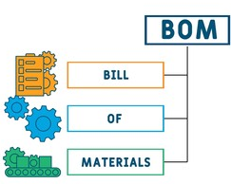

Overview
  Forecasting Prerequisites
    Purchased material cycle
    Bill of Materials
    Warehouses are defined
    Work packages
    User permissions
  Forecasting material Allocation
Achievement
SMAT Forecast Run
Purchased Materials
(Eng. MTO + Contingency)
Work Package
Allocation

Slide 5
Work Package
  What is a work package
    A work package is a user-defined selection of Bill of Materials that allows you to specify a focused scope of work. Essentially, a work package breaks down a larger project into manageable sections for easier planning, tracking, and control.
  Work package examples
    Shutdown BOM
    Tie-In BOM
    BOM without hold
    A specific material
    Early phase
    Issued isometrics for a specific area
    Pipe racks and sleepers
    Hydrotest loop isometrics
Achievement
SMAT Forecast Run

Slide 6



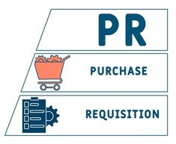
Material Allocation Levels
Achievement
Work Package
SMAT Forecast Run

Slide 7
Forecast Report
    Report Data
      Predicated and actual Dia-inch Workfront chart
      Allocation level Dia-inch summary
      DWG completion status and percentage
Achievement
SMAT Forecast Run

Slide 8
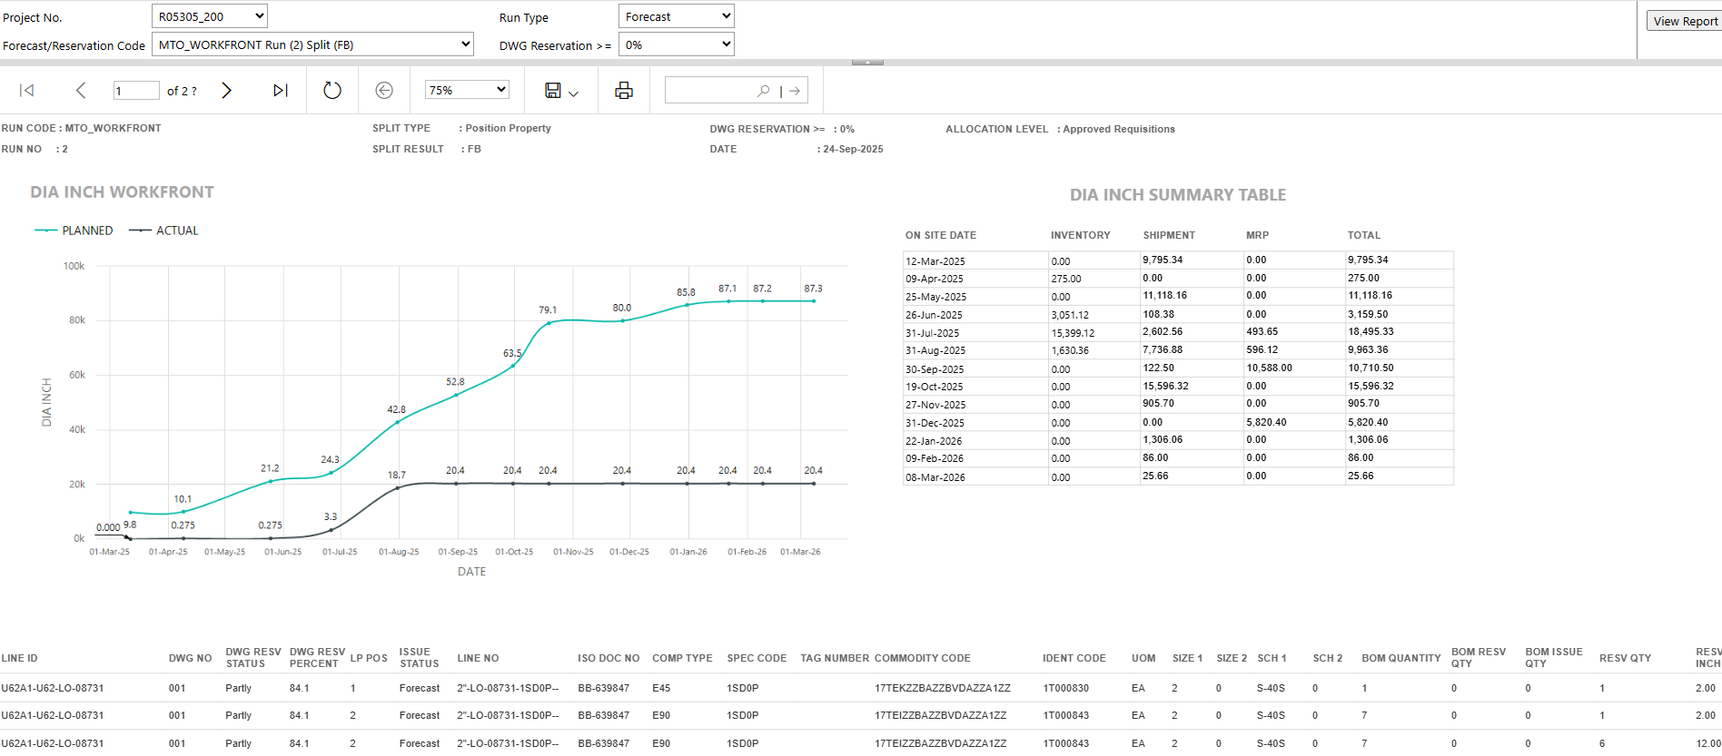
Forecast Report
Achievement
SMAT Forecast Run

Slide 9
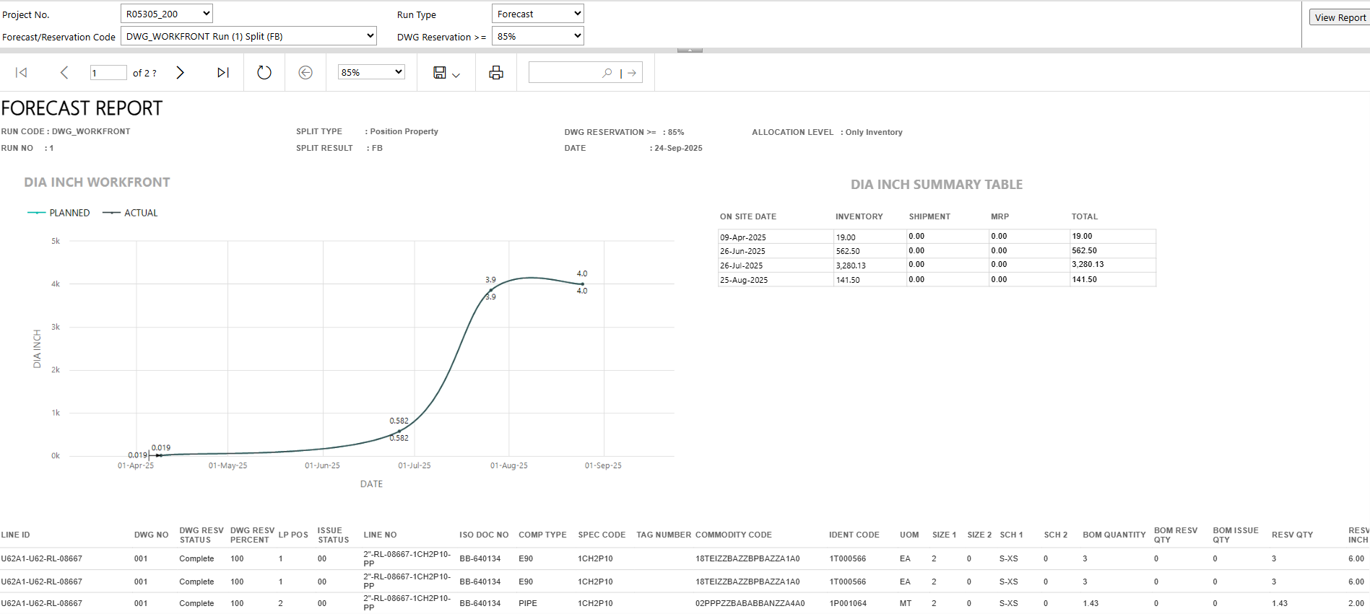
Forecast Report
Achievement
SMAT Forecast Run

Slide 10
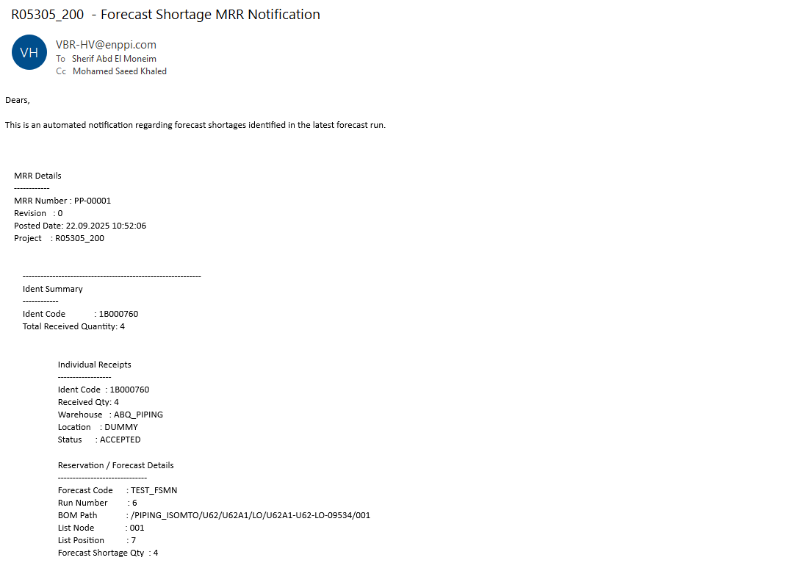
Forecast Shortage Receipt Notifications
Achievement
SMAT Forecast Run
Notes:
automated alerts generated when materials are received that are needed to address a previously forecasted shortage. These notifications inform users in real-time that critical materials projected to be in short supply have now arrived

Slide 11
Forecast Run(FR)
For larger projects, it's important to know specific details in advance for the planning process, figuring out which materials can be prefabricated or installed by certain dates, and to check the material already in transit (shipped items), purchase orders and approved requisitions be delivered by the specified date
Forecast Run (FR) tool. It helps simulate when materials will be available for construction or fabrication, making it easier to plan project work and subcontractor needs. Running a forecast does not impact actual inventory or material quantities.

Slide 12
Material Allocation
Purchased Materials
Work Package
Allocation
Notes:
-Allocate purchased materials to Construction work package
-

Slide 13
Material Allocation Levels
Work Package

Slide 14

Work package
Idents and list positions are the two important concepts to understand before working with work packages.
What is an ident?
Size/ Sch.
A commodity code is an alphanumeric string that is built according to user-definable rules.
An example is PCB100AAXXA each letter or number represents a specific attribute except dimensional information.

Slide 15
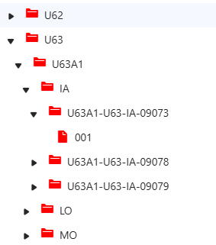
What are Nodes and list positions?
A node is the smallest unit of a hierarchy structure that is linked to one another to define the architecture
(i.e., Unit >> Area >>Fluid >> LineId >> Iso.).
List positions are the positions that are assigned to nodes and describe the ident and property details of that node.
List position = MTO item ( Ident with Qty).

Slide 16
What is a work package
A work package is a user-defined selection of BOM nodes and materials that allows you to define specific Where conditions for the ident and list position selection (scope of material).
They are used in a forecast and reservation run to determine the material that is required to perform scheduled construction tasks.
Where Conditions
So what are these Where conditions?
Where conditions allow you to have a limited view of the database content.
For example, you define where conditions to select specific material from the available material list while performing any audit or process.
We have five types of where conditions available that can be used or selected while creating a work package.

Slide 17
Where Conditions
So what are these Where conditions?
Where conditions allow you to have a limited view of the database content.
For example, you define where conditions to select specific material from the available material list while performing any audit or process.
We have five types of where conditions available that can be used or selected while creating a work package.

Slide 18
Material Where Condition
Through this condition, you can limit the idents (material) to be selected from the BOM by the forecast/reservation run.
BOM Where Condition
Through this condition, you can limit the WBS nodes and BOM list positions to be selected from the BOM by the forecast/reservation run.
e Condition
Mandatory Material Where Condition
Through this condition, you can define a set of specific material (mandatory list positions) that is necessary for starting the installation. This where condition is used by the forecast/reservation run shortage option.

Slide 19
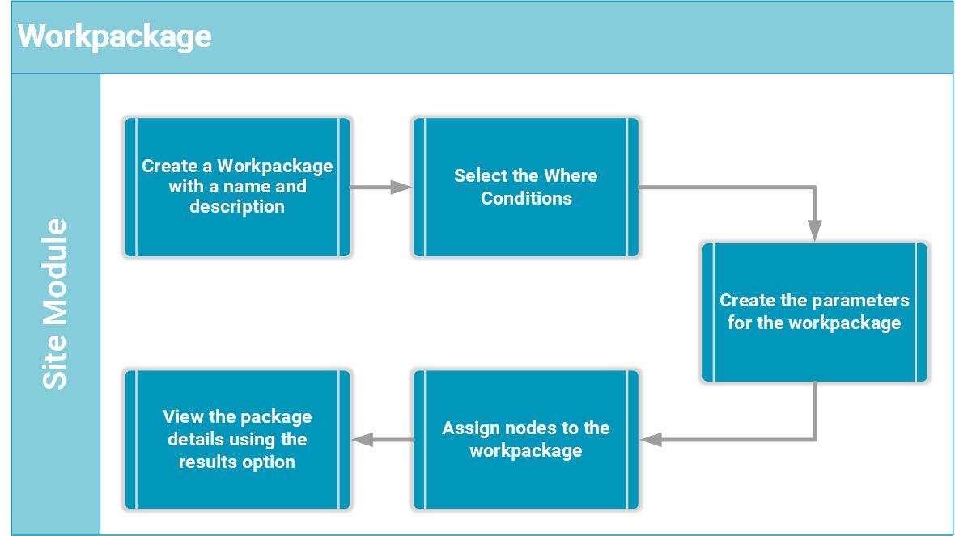
Work package workflow

